Slide 1

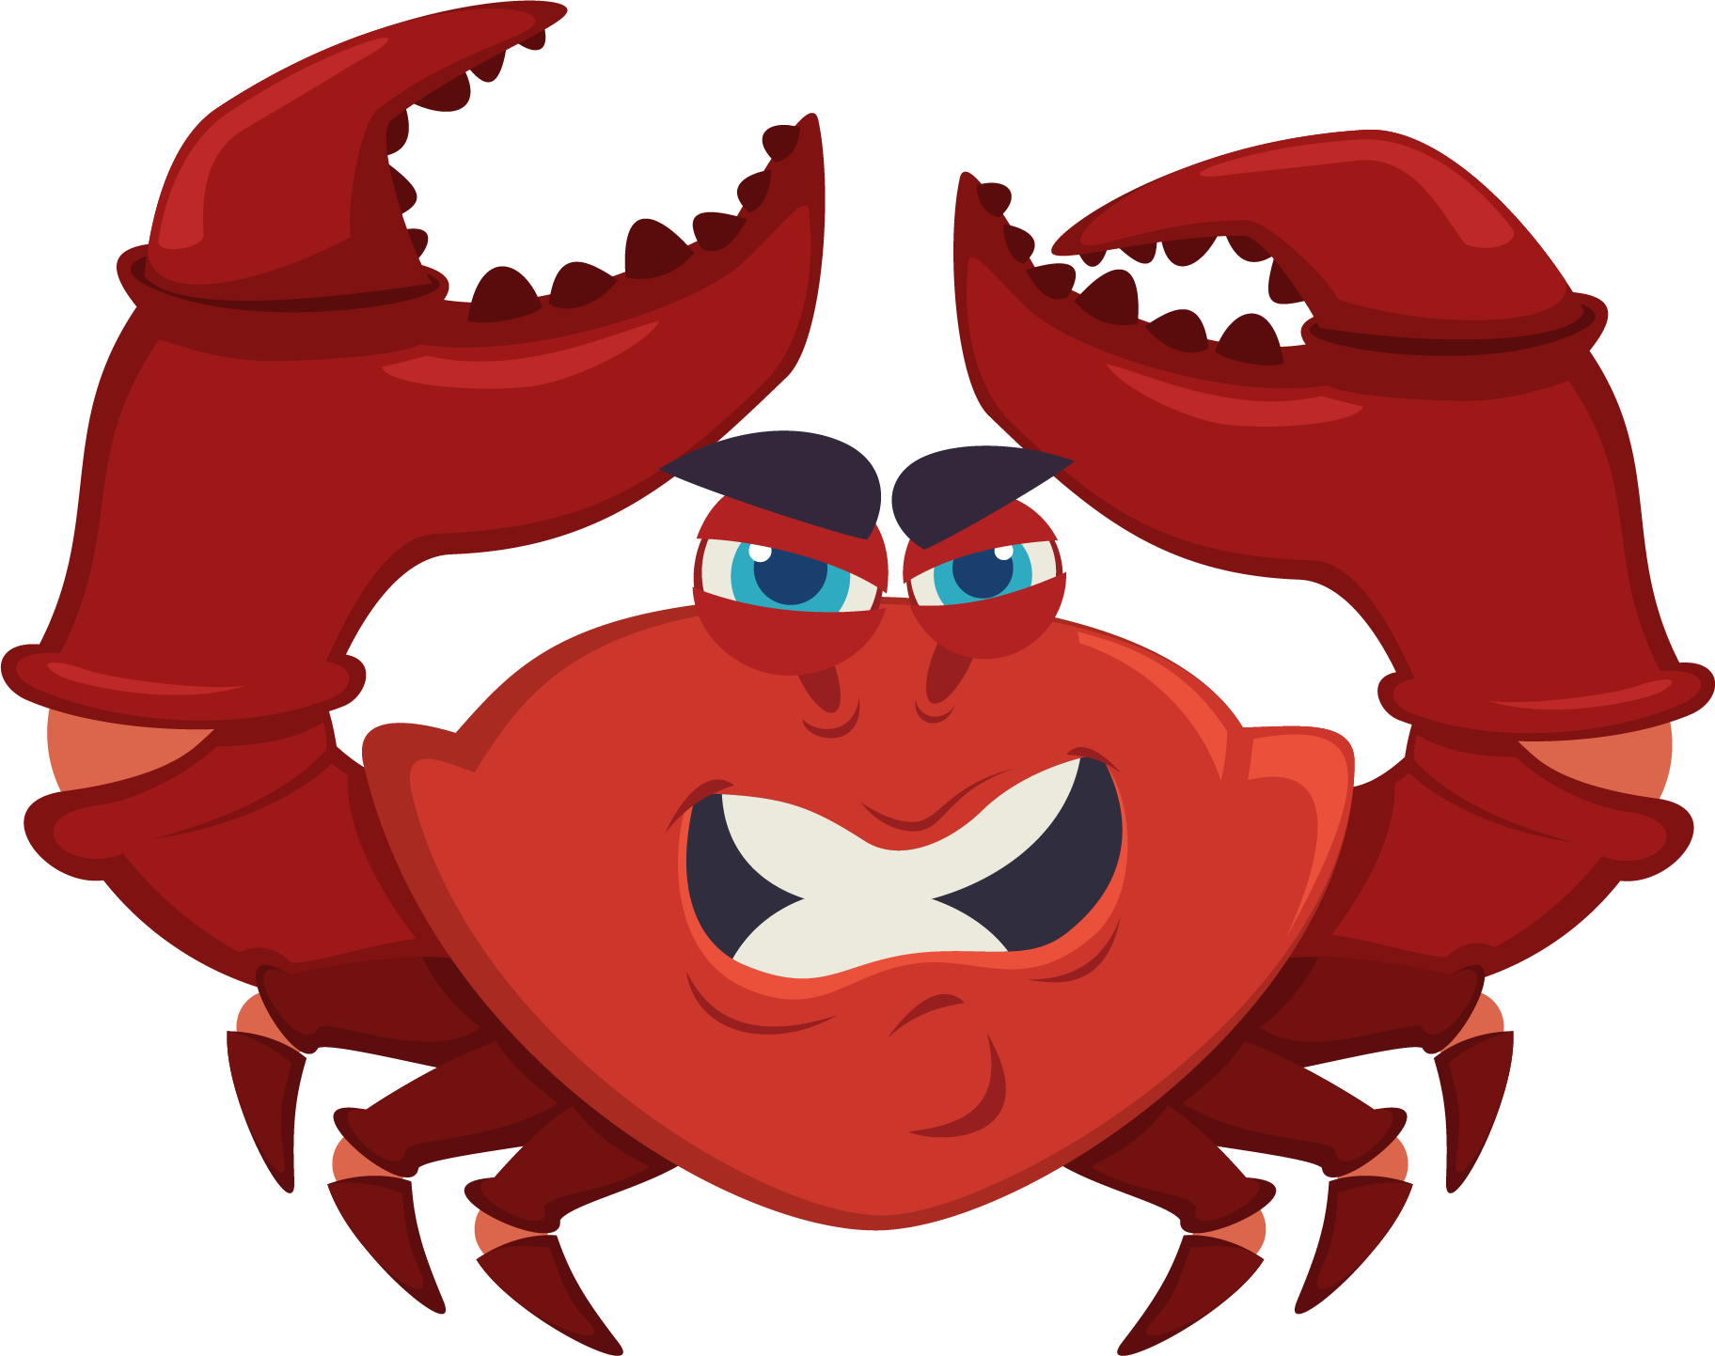

Lesson 6:
Turtle Crossing

Slide 2
Slide

Slide 3
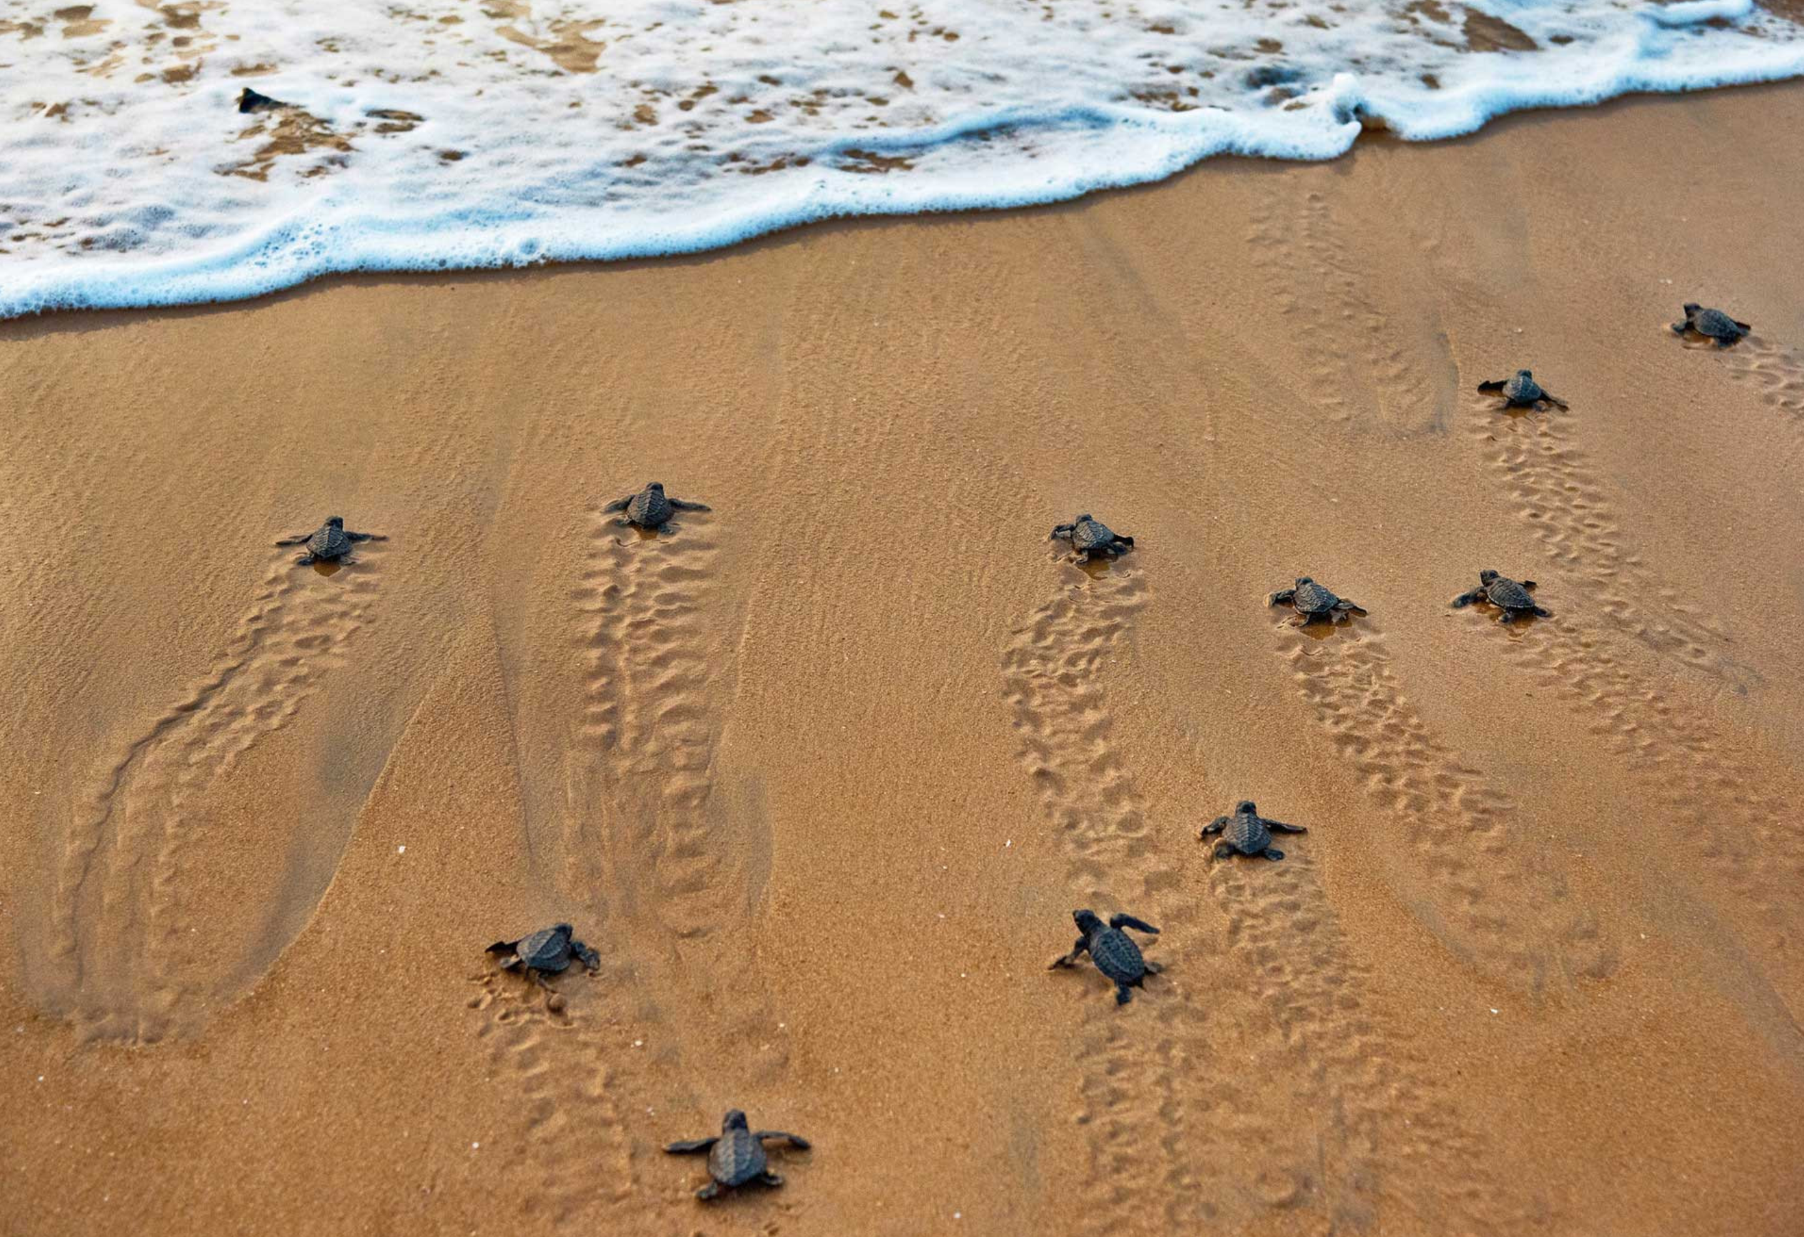
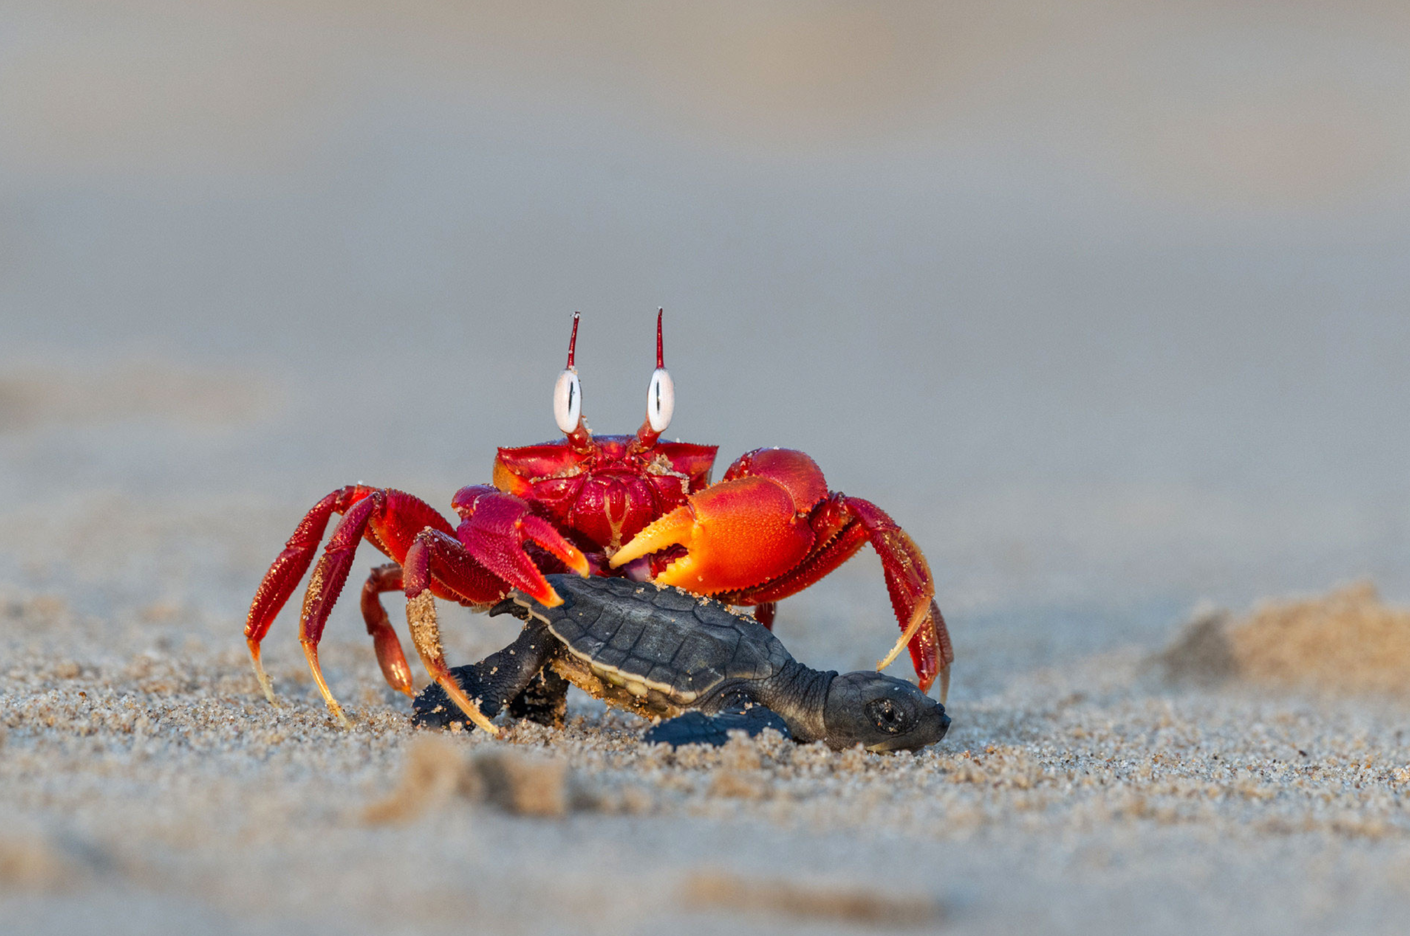
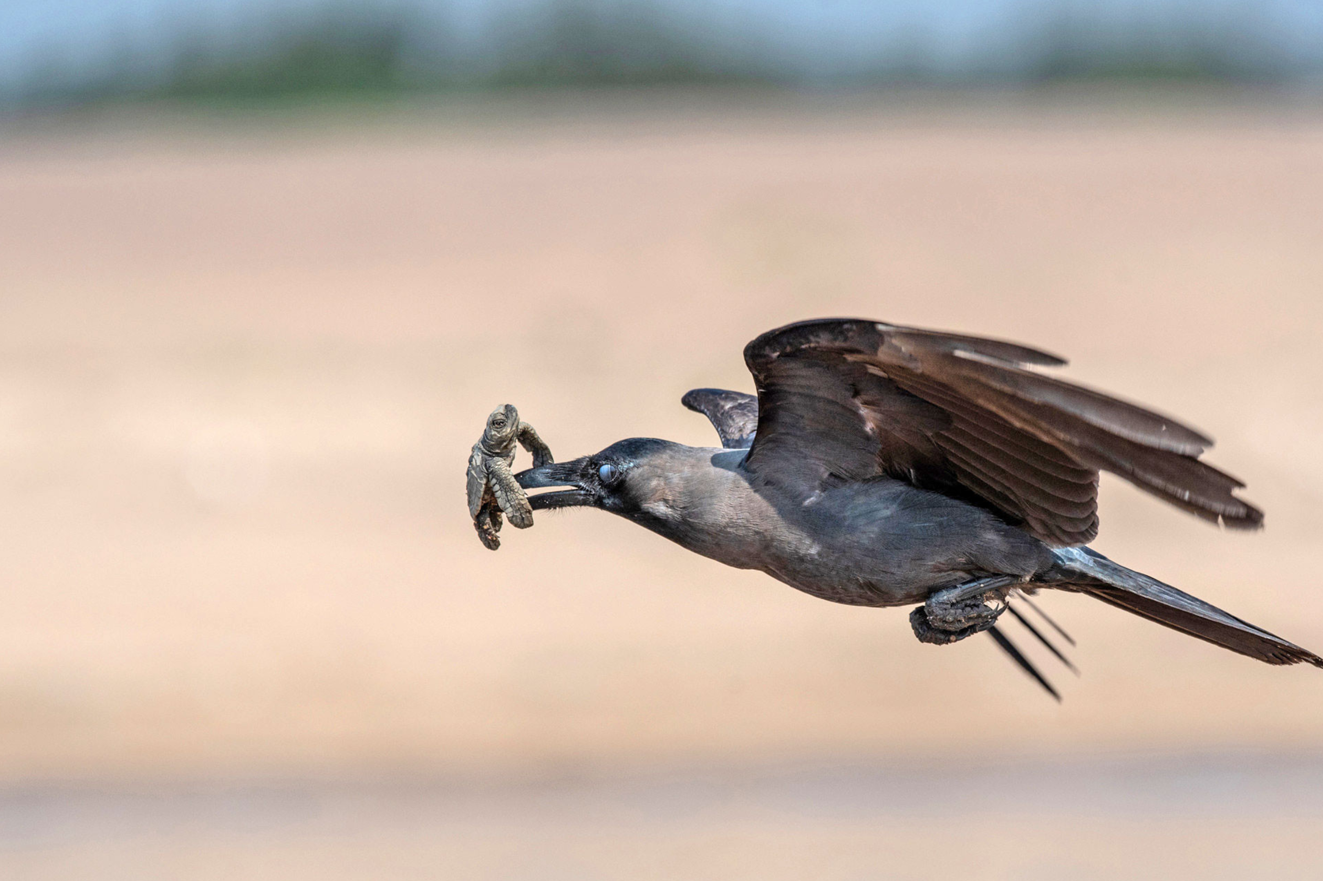
Dangerous Journey…

Slide 4

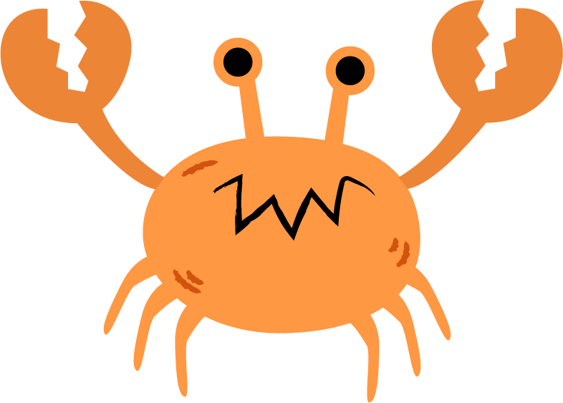

Turtle Crossing

Slide 5

Pick a Local Backdrop
Scratch for Newbies
Level1
Lesson 6 – Turtle Crossing
Resources
Backdrop
beach.png

Slide 6
Pick a Local Turtle
Scratch for Newbies
Level1
Lesson 6 – Turtle Crossing
Resources
Sprites
turtle.png

Slide 7



Set Turtle Up

Slide 8
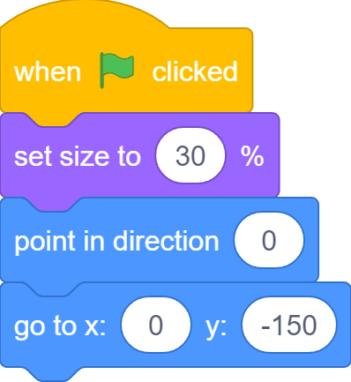
Set Turtle Up

Slide 9
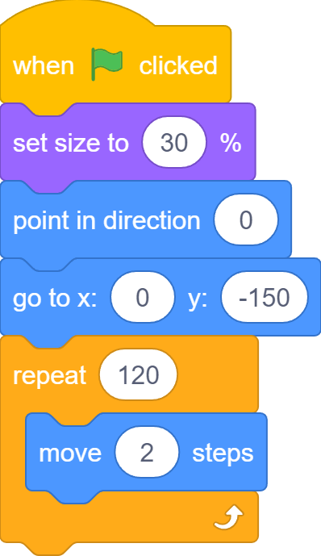
Move to Ocean

Slide 10



Change Turtle Direction

Slide 11



Game Controls

Slide 12




Control Turtle Direction

Slide 13
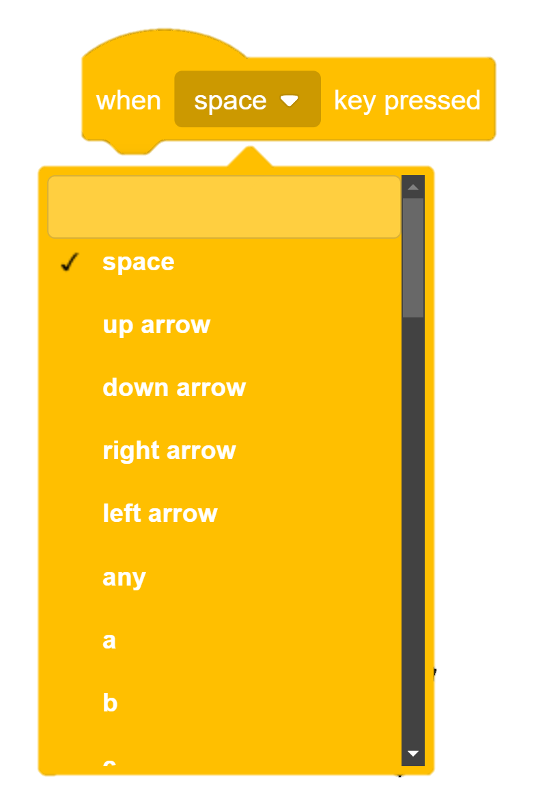
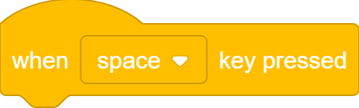
When Key Pressed…

Slide 14
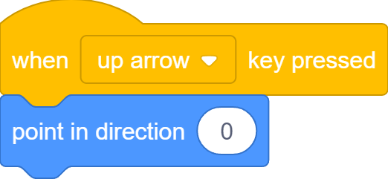
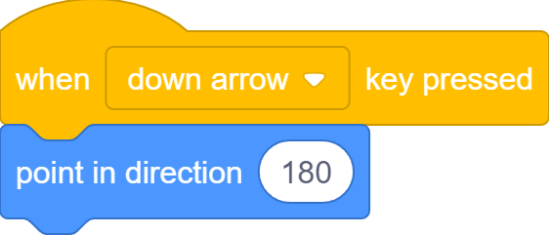

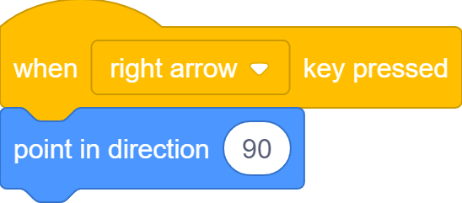
When Key Pressed…

Slide 15
Move to Ocean

Slide 16
When Key Pressed…

Slide 17
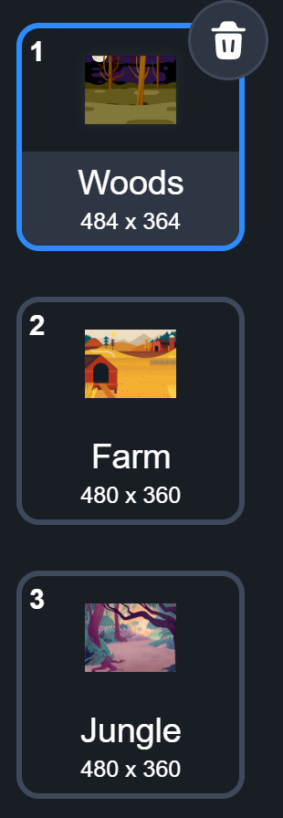
What we learnt…
How to create levels for games using backdrops

Slide 18
Exercises
Can you add even more distractions to the game?
Can you increase the amount of distraction as the players progress from level to level?
What else can you do to make it even harder to find the bug? (think about different effects you can apply to sprites)
Play the game with friends and families to see who is the best bug finder!

Slide 19
Thank you and see you in the next lesson!

